Slide 1
POTHR MP-Z REVEAL Moneypenny & Zensai
FEBRUARY
3RD 2022
Spike protein secret & cell suicide revelation
The Reason They Had To Vaccinate So Many ?
The BIG REVEAL

Slide 2
POTHR CLUBHOUSE – MPZ Hypothesis
This Clubhouse Room contains content primarily discovered by ‘Moneypenny Nic’ as a part of her ongoing research into the SARS-COV-2 pandemic, the virus, the vaccines, the theories, the evidence and the fakes, frauds and fallacies Many thanks to Preservation Of The Human Race for Agreeing to Host this special room 03/03/22
ALL TONIGHT’S CONTENT can be sourced and referenced from peer reviewed scientific studies published in The Lancet, Nature, BMJ, NIH, FDA, CDC, National Newspapers & YouTube videos which remain live and have passed fact-checks.

Slide 3
Moneypenny Research – We’ve been SPIKED
What do we all have in common now in 2022 ?
Infected, Injected or Selected ?
MSH3 Homology & Moderna Patent
MSH3 naturally within human body – makes enzymes, too many?
12-19 nucleotides in the sequence – first CV ever to see this
Furin Cleavage Gene Sequence NEW & ADDED (1 in 3 Trillion chance)
DNA Repair Normal & Abnormal – MSH pairings
Permanent Cell Damage Process & No suicide
IMPLICATIONS & CONCLUSIONS

Slide 4
SPIKE PROTEIN – new discoveries
IS All Spike Protein Toxic ?
IS the whole of the SP dangerous?
DNA & RNA
Gene Sequences
Furin Cleavage

Slide 5
WHY Might We All Have A Ticking Timebomb ?
Infected by SARS-COV-2 + Vax/Unvax
Not infected And Not Vaxxed – Shedding Contamination
Injected with a SARS-COV-2 vaccine – unknown infection status
INJECTED with XXXXX but not infected – or corrected ?
MSH3 HYPOTHESES
ACCUSED: MODERNA PATENT
(tiny part of DNA sequence found was patented THREE YEARS BEFORE in 2016)

Slide 6
Moderna – Vax is Their ONLY commercial product
DNA Sequence IN SARS-COV-2
Patented THREE YEARS before
Causes CELLS to mutate and die or replicate as cancer
MAINSTREAM News & 1000s SCIENTISTS & RESEARCHERS AGREE

Slide 7
DNA Cell Damage & Repair
Cells Irreversibly Damaged
Natural Suicides Prevented
Bad Cells Remain
LEADS TO
Cancers & Serious Cell-Based Illness
Much longer time of infection
Much more severe illness

Slide 8
PART 1: conclusion – We All Have Damaged Cells?
Are All Vaccines Contributing?
What About Novavax ?
What About Sputnik?
China, US, Europe, Russia
FROM RUSSIA WITH LOVE?
NOVAVAX
Task 1
Task 2
COMIRNATY & SPIKEVAX
Task 1
Task 2
NEW SPIKE PROTEIN SAFETY ?
Task 1
Task 2

Slide 9
OR could some vaccines evade this danger?
NOVAVAX
Recombinant protein based
A UNIQUE spike protein is made & inserted into a different virus…moth cells…new SP harvested and protein (plant based) used as the adjuvant
OTHERS ???????
What VACCINES were used in the different countries around the world?
USA Pfizer MRNA
EUROPE PF & Moderna & AZ
UAE Turkovax..
RUSSIA
CHINA

Slide 10
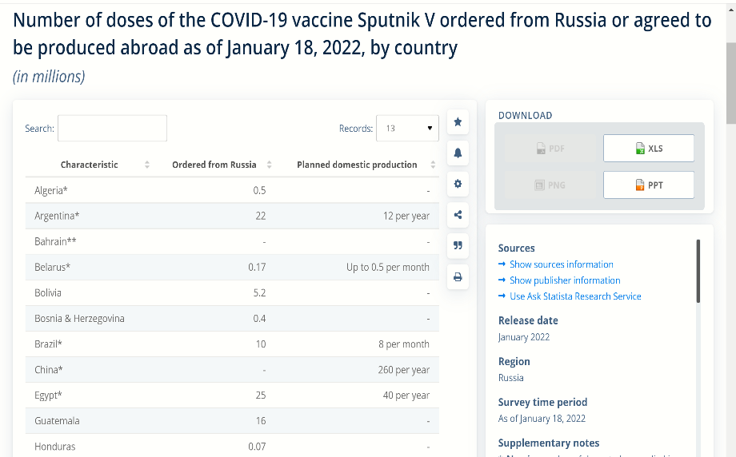
POTHR CLUBHOUSE – MPZ Hypothesis NOVAVAX, RUSSIA, EXPORTS……. WHO WANTED IT AND WHY?

Slide 11
POTHR CLUBHOUSE – MPZ Hypothesis
This Clubhouse Room contains content primarily discovered by ‘Moneypenny Nic’ as a part of her ongoing research into the SARS-COV-2 pandemic, the virus, the vaccines, the theories, the evidence and the fakes, frauds and fallacies Many thanks to Preservation Of The Human Race for Agreeing to Host this special room 03/03/22
ALL TONIGHT’S CONTENT can be sourced and referenced from peer reviewed scientific studies published in The Lancet, Nature, BMJ, NIH, FDA, CDC, National Newspapers & YouTube videos which remain live and have passed fact-checks.

